Slide 1
Recap of what we did yesterday

Slide 2
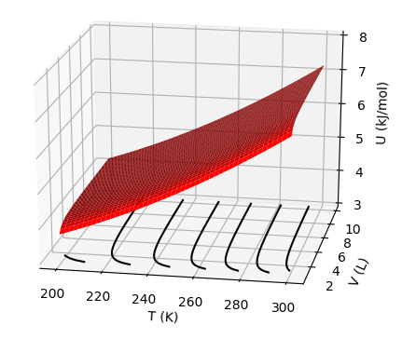
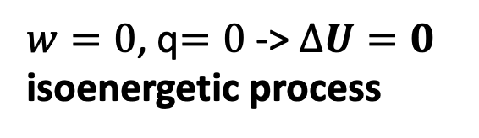
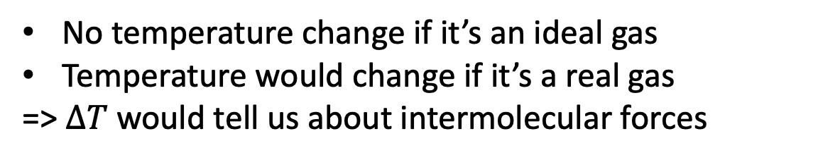
$w=0$, q$=0$ -> $∆U=0$
isoenergetic process
Joule experiment is adiabatic, and no work is done
Vacuum
No temperature change if it’s an ideal gas
Temperature would change if it’s a real gas
=> $∆T$ would tell us about intermolecular forces

Slide 3
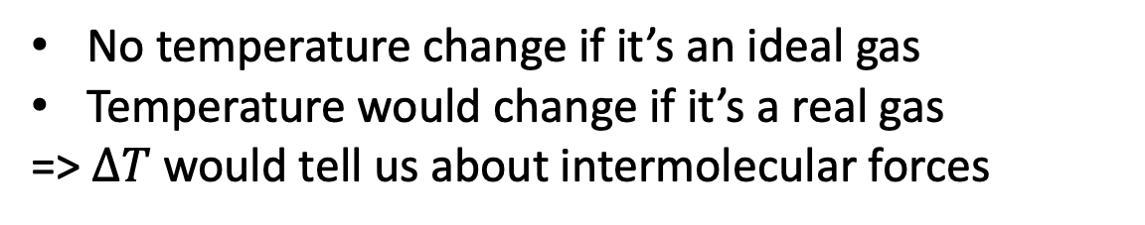
$w=0$, q$=0$ -> $∆U=0$
isoenergetic process
Joule experiment is adiabatic, and no work is done
Vacuum
Balloon pops
No temperature change if it’s an ideal gas
Temperature would change if it’s a real gas
=> $∆T$ would tell us about intermolecular forces

Slide 4
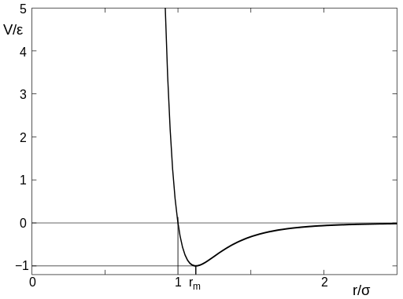
$w=0$, q$=0$ -> $∆U=0$
isoenergetic process
Joule experiment is adiabatic, and no work is done
Climbing uphill in potential energy would cause molecules to slow down, hence lower temperature
d

Slide 5
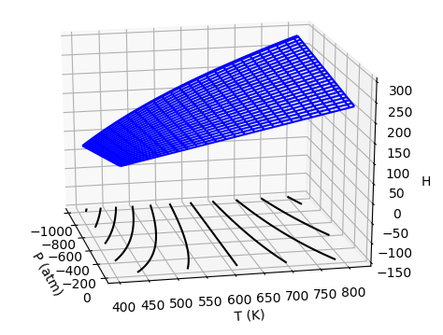
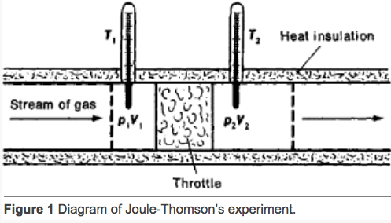
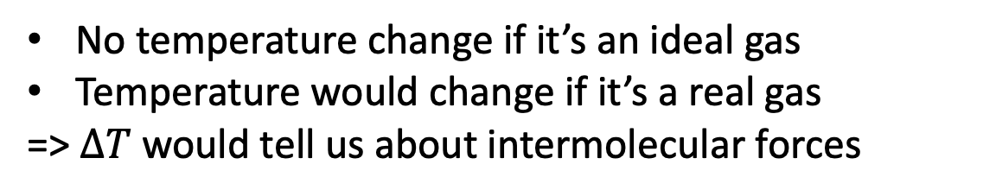
Joule-Thomson experiment is also adiabatic, but work is done
$w≠0$, q$=0$ -> $∆U≠0$/ . But $∆H=0$ … it’s an isenthalpic process (we’ll prove this later)
No temperature change if it’s an ideal gas
Temperature would change if it’s a real gas
=> $∆T$ would tell us about intermolecular forces
https://encyclopedia2.thefreedictionary.com/Joule-Thomson+Effect

Slide 6

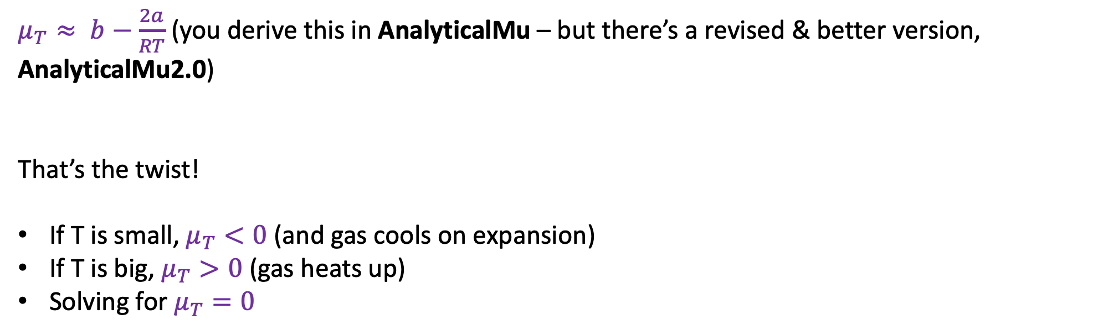
Joule-Thomson: Thermodynamic analysis
$μ_{T}≈ b−\frac{2a}{RT}$ (you derive this in AnalyticalMu – but there’s a revised & better version, AnalyticalMu2.0)
That’s the twist!
If T is small, $μ_{T}<0$ (and gas cools on expansion)
If T is big, $μ_{T}>0$ (gas heats up)
Solving for $μ_{T}=0$
$$T_{inversion}=…$$

Slide 7

Joule-Thomson: Thermodynamic analysis
$μ_{T}≈ b−\frac{2a}{RT}$ (you derive this in AnalyticalMu – but there’s a revised & better version, AnalyticalMu2.0)
That’s the twist!
If T is small, $μ_{T}<0$ (and gas cools on expansion)
If T is big, $μ_{T}>0$ (gas heats up)
Solving for $μ_{T}=0$
$$T_{inversion}=2\frac{a}{bR}$$

Slide 8
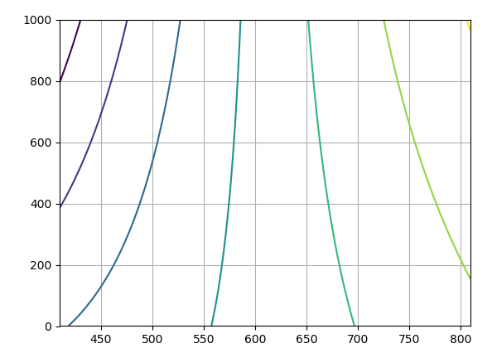
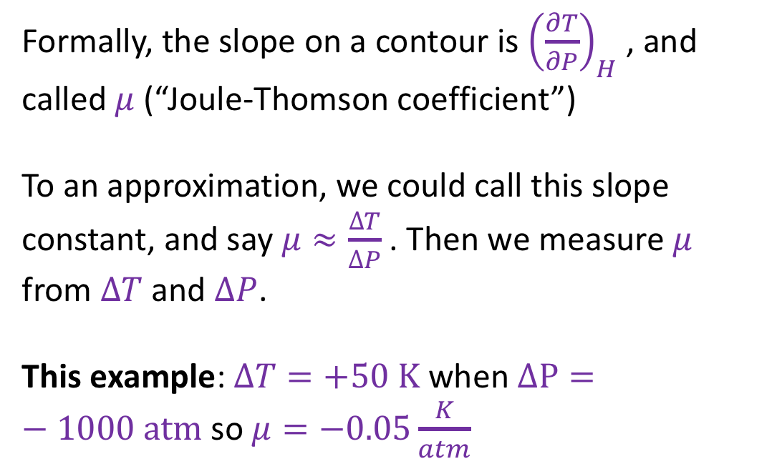
Joule-Thomson: Application
Formally, the slope on a contour is ${\left(\frac{∂T}{∂P}\right)}_{H}$ , and called $μ$ (“Joule-Thomson coefficient”)
To an approximation, we could call this slope constant, and say $μ≈\frac{∆T}{∆P}$ . Then we measure $μ$ from $∆T$ and $∆P$.
This example: $∆T=+50 K$ when $∆P=−1000 atm$ so $μ=−0.05\frac{K}{atm}$
P (atm)
T (K)

Slide 9
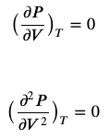




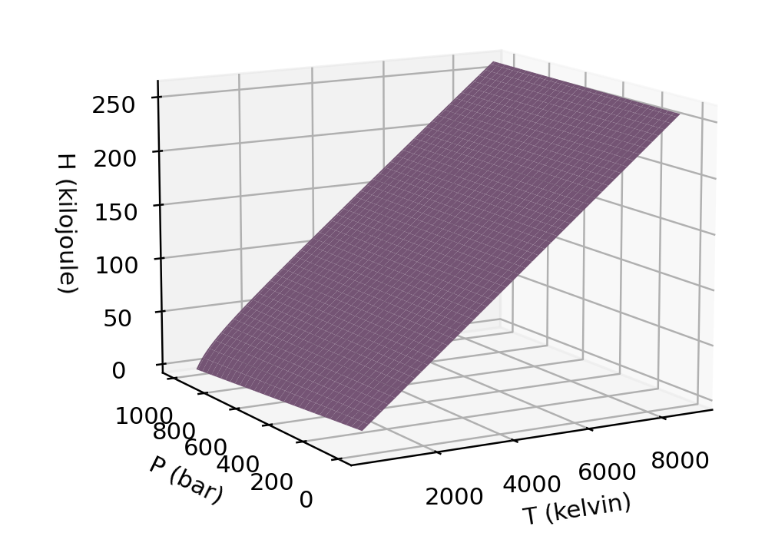
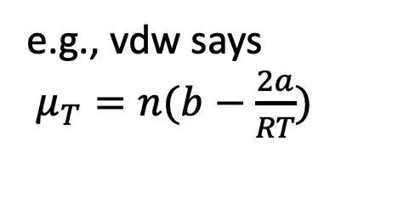


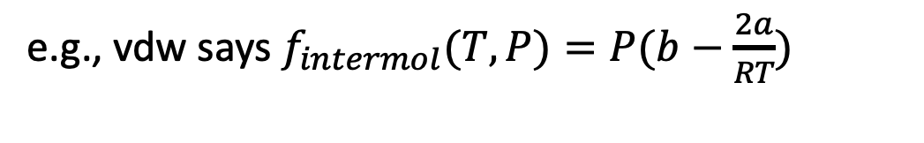
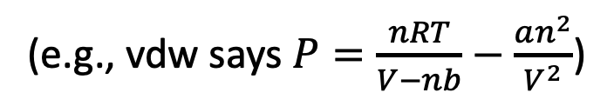
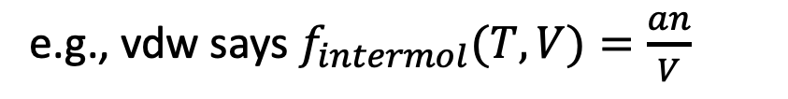

(e.g., vdw says $P=\frac{nRT}{V−nb}−\frac{an^{2}}{V^{2}}$)
(AnalyticalTcrit)
$P=P(T,V)$
$T_{crit}$, $V_{crit}$
(AnalyticalMu)
e.g., vdw says
$π_{T}=−\frac{an^{2}}{V^{2}}$
e.g., vdw says
$μ_{T}=n(b−\frac{2a}{RT})$
Math
181
Math
180
(AnalyticalH)
Math
181
Math
180
e.g., vdw says $f_{intermol}(T,V)=\frac{an}{V}$
e.g., vdw says $f_{intermol}(T,P)=P(b−\frac{2a}{RT})$
(VisualizingH)

Slide 10
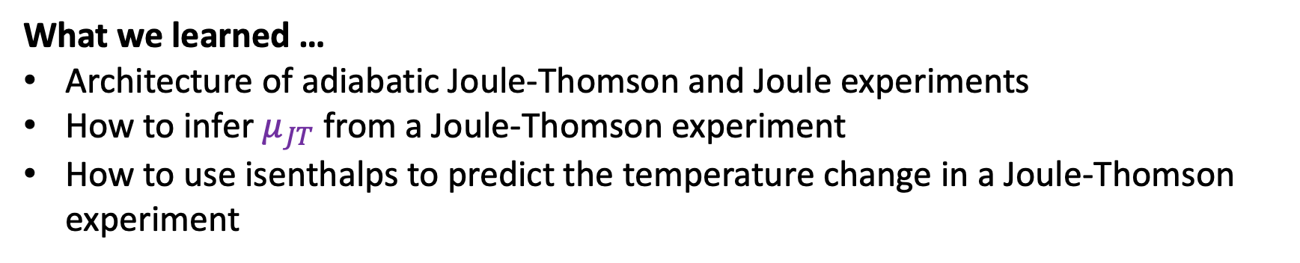
What we learned …
Architecture of adiabatic Joule-Thomson and Joule experiments
How to infer $μ_{JT}$ from a Joule-Thomson experiment
How to use isenthalps to predict the temperature change in a Joule-Thomson experiment

